Slide 1
Results experiment Reward
EMG (+ EEG)
april 2026

Slide 2

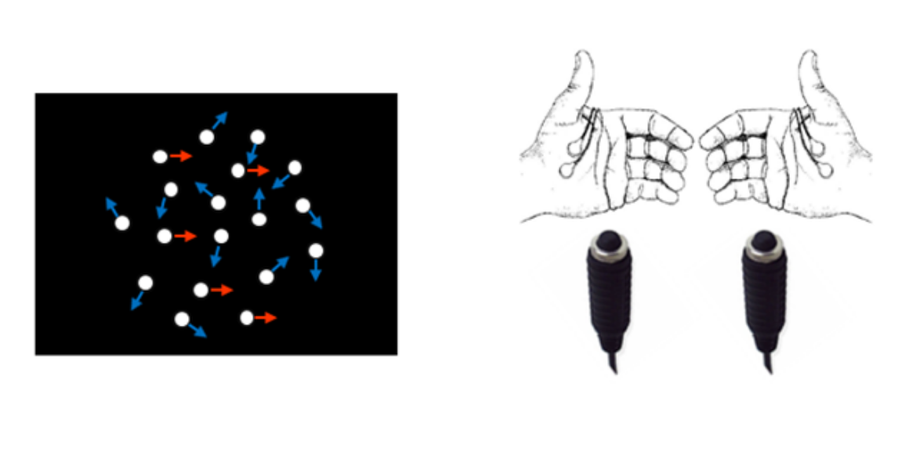


Experimental design: this is a response-signal RDM task with 3 s delay. Trial value (regular vs. critical) was manipulated to modulate potential score gains, with critical trials yielding higher rewards. This manipulation was designed to encourage participants to “replay” their decision at the response signal (RS).
Start trial
Stimulus offset
RS
(cross to circle)
+
+
+
+
Fixation
(0.8s)
+ 10 points
Stimulus (0.8s)
Delay (3s)
Response Signal
(4s deadline)
Feedback
(0.8s)
ITI - Eye blinking
(random 0.8, 1, 1.2s)
Color indicates trial value
Reward-onset timing:
start trial
stimulus offset
RS
+
+
+
No information
Regular
(or critical)
Critical
(or regular)

Slide 3
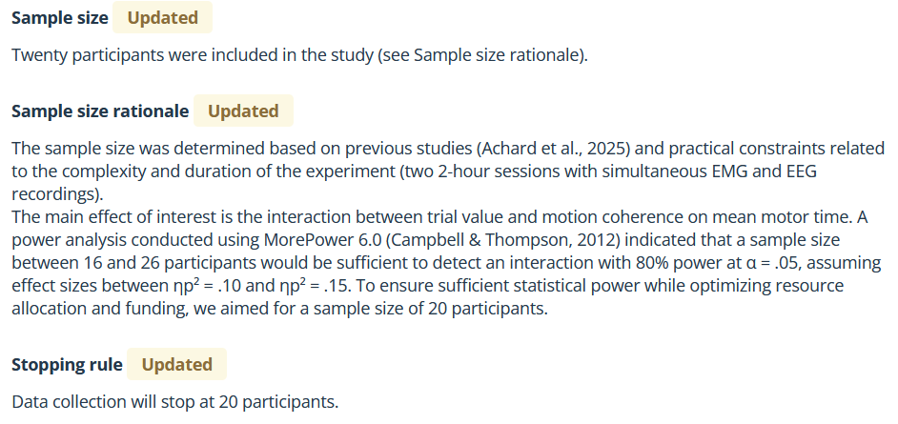
Notes. The proportion of valid trials (after applying the exclusion criteria listed below) was 97.83% (range: 92.99–99.72%). Excluded trials comprised: anticipated responses (RT < 0.2 s; 0.18%, range: 0–1.32%), missed trials (0.32%, range: 0–2.01%), trials in which EMG could not be detected (1.55%, range: 0–12.5%), premature responses (before RS; 0.84%, range: 0.07–3.40%), and trials with technical problems (0.00%, range: 0–0.07%). All analyses were performed on valid trials (correct and incorrect).

Slide 4
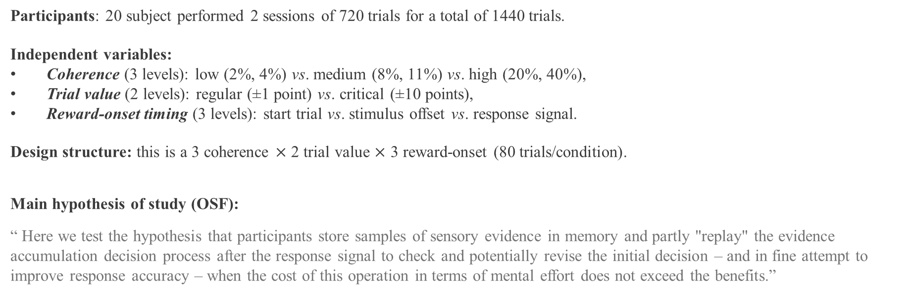
Participants: 20 subject performed 2 sessions of 720 trials for a total of 1440 trials.
Independent variables:
Coherence (3 levels): low (2%, 4%) vs. medium (8%, 11%) vs. high (20%, 40%),
Trial value (2 levels): regular (±1 point) vs. critical (±10 points),
Reward-onset timing (3 levels): start trial vs. stimulus offset vs. response signal.
Design structure: this is a 3 coherence $×$ 2 trial value $×$ 3 reward-onset (80 trials/condition).
Main hypothesis of study (OSF):
“ Here we test the hypothesis that participants store samples of sensory evidence in memory and partly "replay" the evidence accumulation decision process after the response signal to check and potentially revise the initial decision – and in fine attempt to improve response accuracy – when the cost of this operation in terms of mental effort does not exceed the benefits.”
Before turning to partial muscle activations, let’s first examine accuracy, mean RT, mean premotor execution time (PMET), mean motor execution time (MET) and the averaged muscle activation profile leading up to the response.

Slide 5
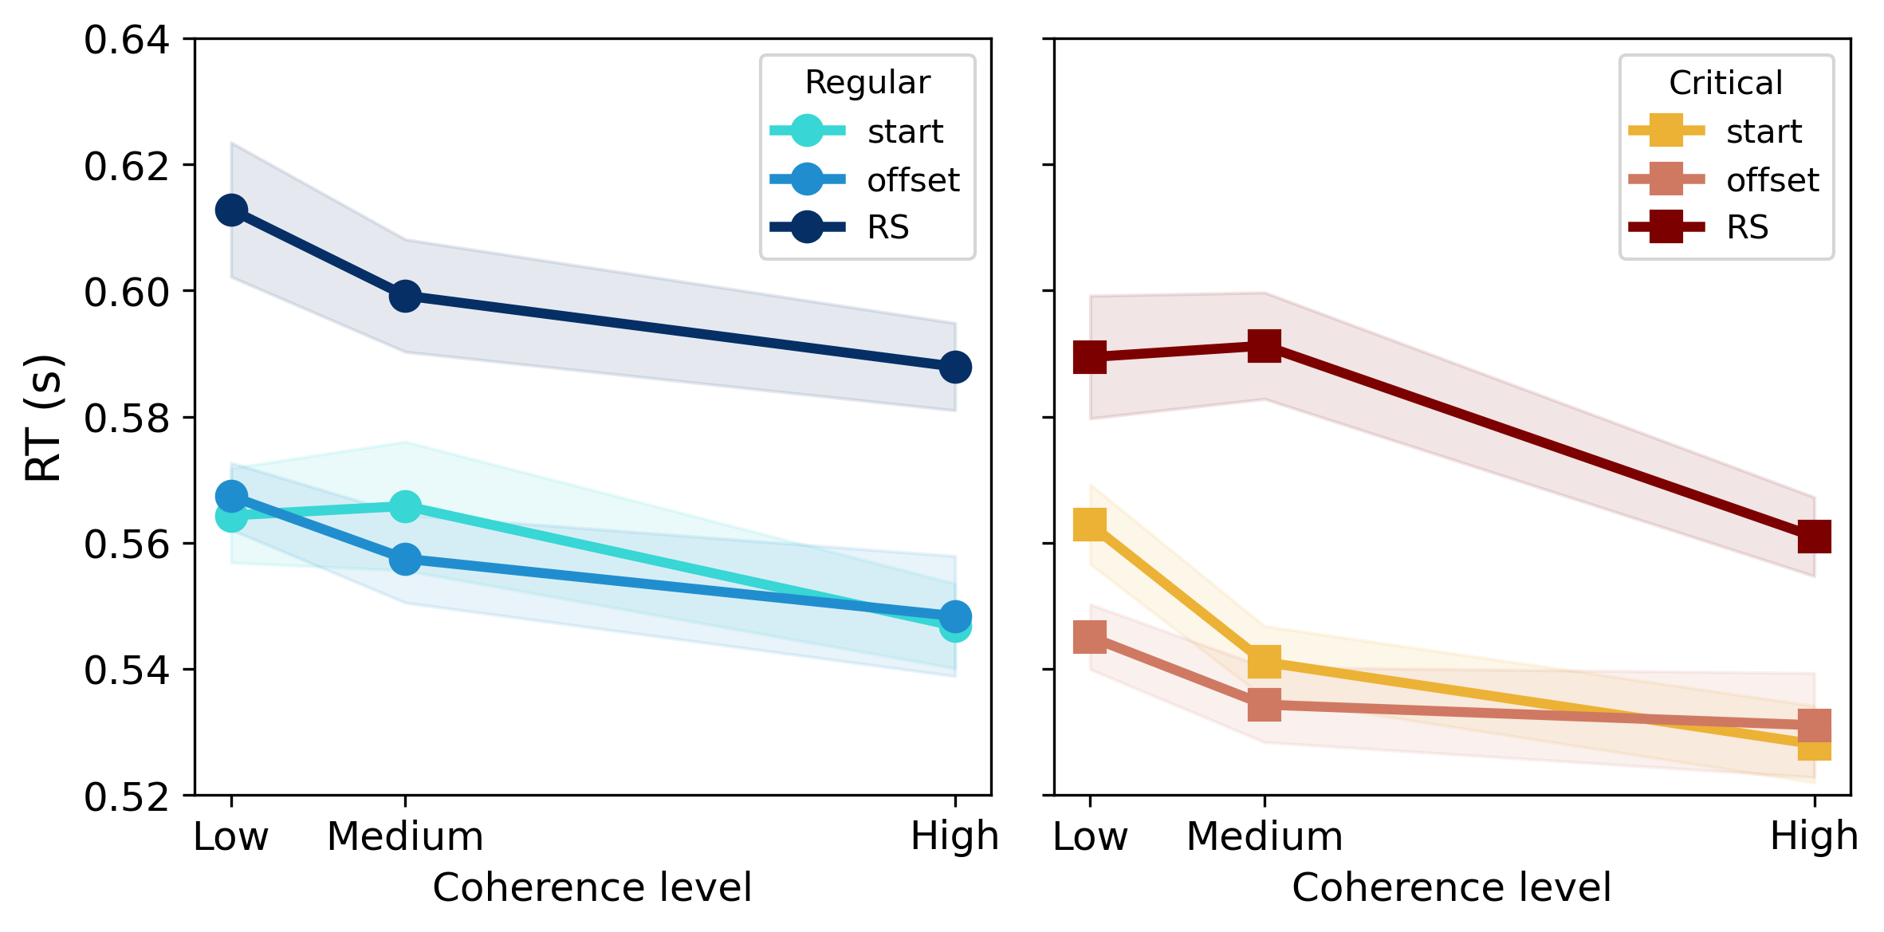
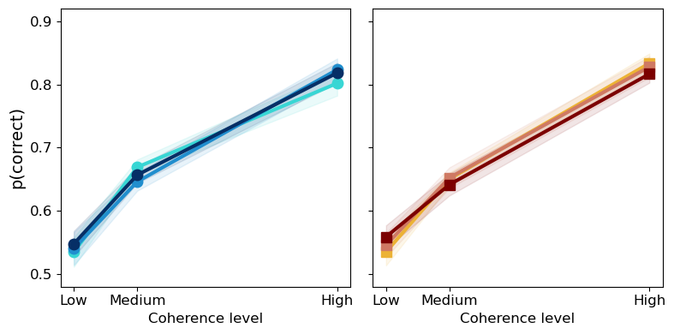
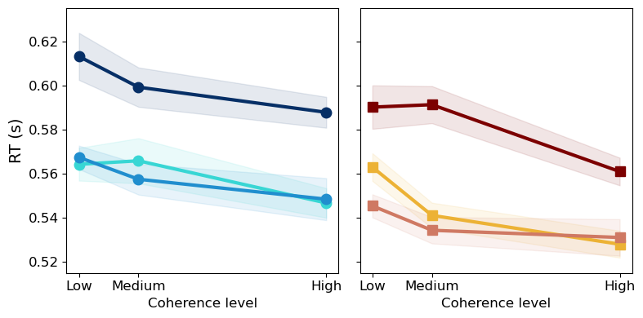
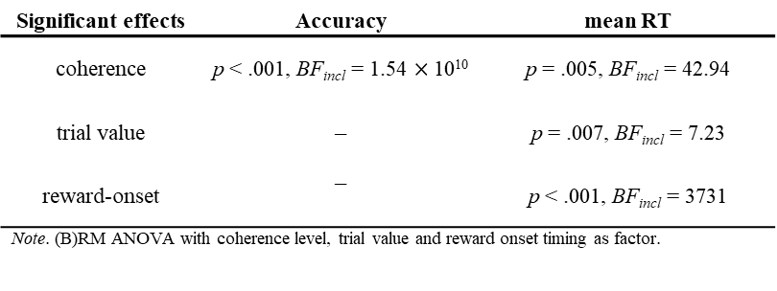
Mean RT was slower in regular than critical trials, and when reward information was presented at the RS compared to other timings (start of trial and stimulus offset).
Significant effects | Accuracy | mean RT
coherence | p < .001, BF_{incl} = 1.54 $×$ 10¹⁰ | p = .005, BF_{incl} = 42.94
trial value | – | p = .007, BF_{incl} = 7.23
reward-onset | – | p < .001, BF_{incl} = 3731
Note. (B)RM ANOVA with coherence level, trial value and reward onset timing as factor.
Notes legend
Plots were divided in two subplot: left (blue) for regular trial and right (red) for critical trial.
Colors palette (light to dark) indicates the moment when the reward is delivered (reward-onset timing: start of trial, stimulus offset or RS).
Notes:
Accuracy
Mean accuracy increased with coherence.
No difference observed between trial value or reward-onset timing.
Mean RT
Mean RT seems decrease as coherence level increased.
It was higher for regular than critical trials.
It was higher for RS reward-onset compared to others.

Slide 6
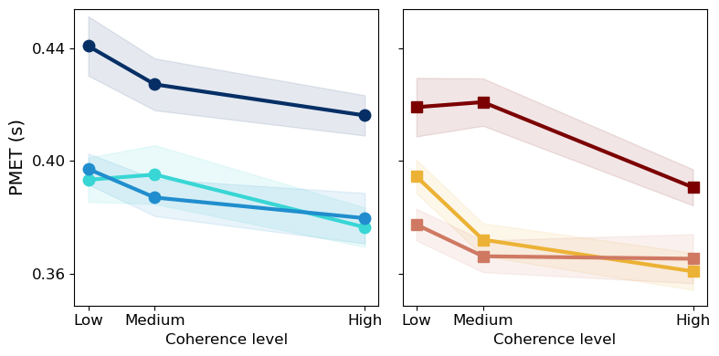
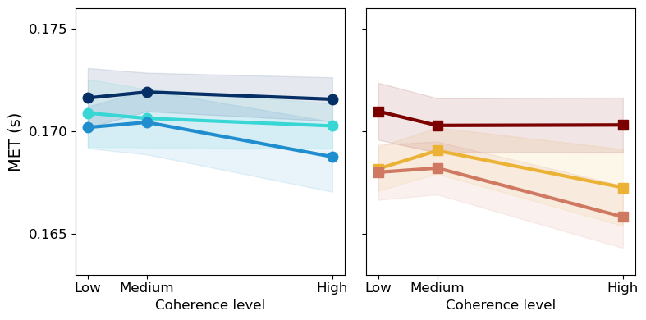
“We predict that the magnitude of the effect of motion coherence on mean PMT, and slope of muscle activation will be larger for critical than regular trials, reflecting a stronger attempt to "replay" the decision. In line with the predicted effect on the slope of muscle activation, we also predict that the effect of motion coherence on mean motor time (MT, from the onset of muscle activation to the response) will be larger for critical than regular trials.”
Similar trends were observed for mean PMET as for mean RT.
Mean MET appeared unaffected by the independent variables, except trial value with higher latency for regular trial (blue).
Significant effects | mean PMET | mean MET
coherence | p = .01, BF_{incl} = 15.19 | –
trial value | p = .012, BF_{incl} = 4.56 | p = .015, BF_{incl} = 2.34
reward-onset | p < .001, BF_{incl} = 1492 | –
Note. (B)RM ANOVA with coherence level, trial value and reward onset timing as factor.
Notes:
Hypothesis = “magnitude of the effect of motion coherence (…) will be larger for critical than regular trials, reflecting a stronger attempt to "replay" the decision”
→ pas d’effet d’interaction coherence × trial value sur mean PMET et MET donc hypothèse de ‘replay’ rejetée

Slide 7
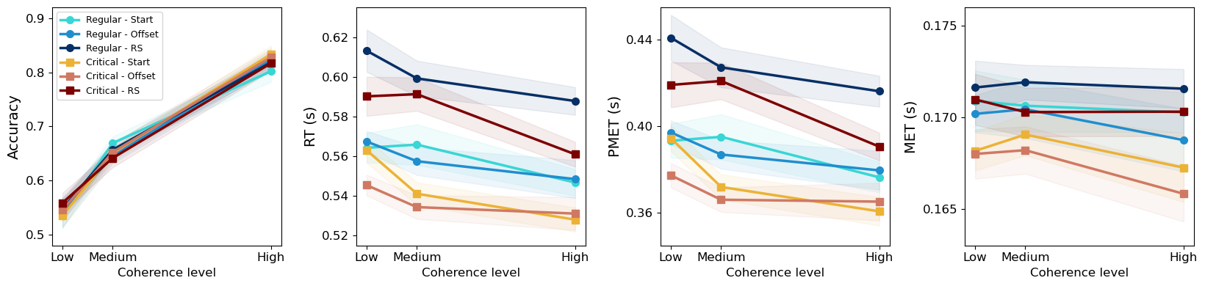
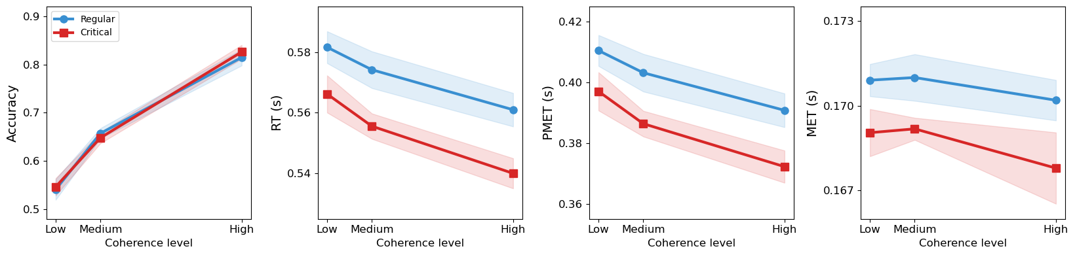
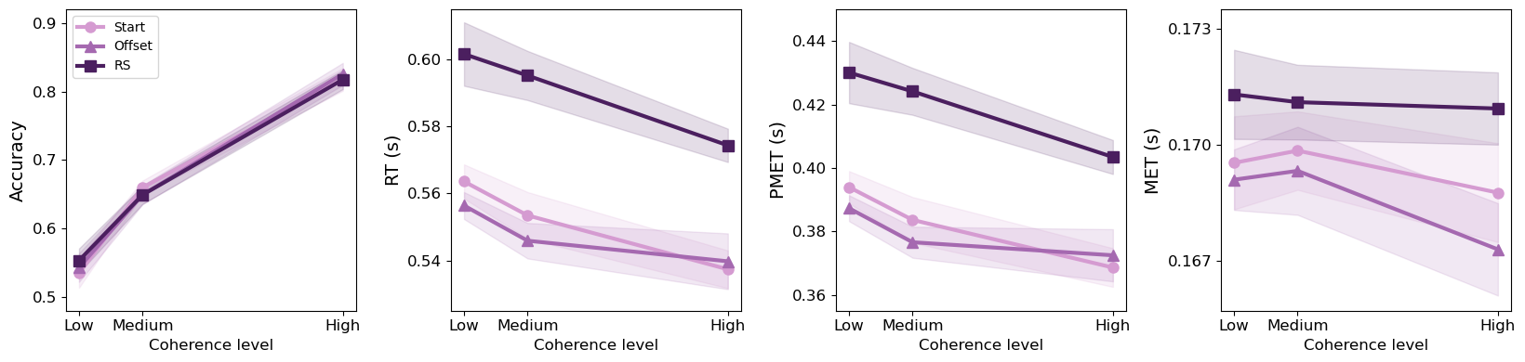
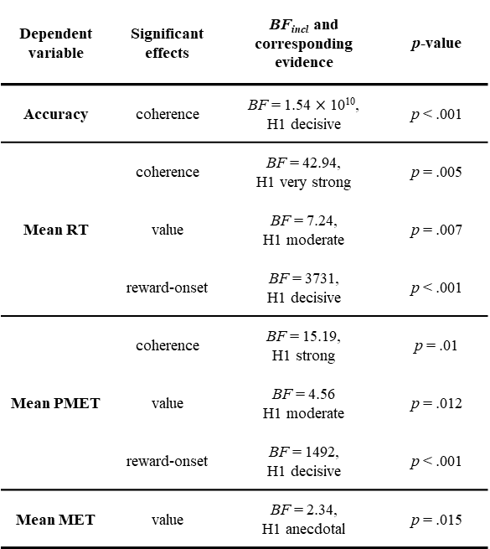
Summary
Table 1
Significant effects from the ANOVAs on response accuracy, mean response time (RT), mean pre-motor execution time (PMET), and mean motor execution time (MET)
Dependent variable | Significant effects | BF_{incl} and corresponding evidence | p-value
Accuracy | coherence | BF = 1.54 $×$ 10¹⁰, H1 decisive | p < .001
Mean RT | coherence | BF = 42.94, H1 very strong | p = .005
 | value | BF = 7.24, H1 moderate | p = .007
 | reward-onset | BF = 3731, H1 decisive | p < .001
Mean PMET | coherence | BF = 15.19, H1 strong | p = .01
 | value | BF = 4.56 H1 moderate | p = .012
 | reward-onset | BF = 1492, H1 decisive | p < .001
Mean MET | value | BF = 2.34, H1 anecdotal | p = .015

Slide 8
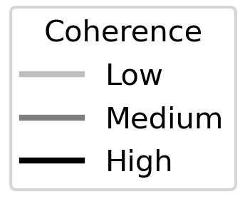
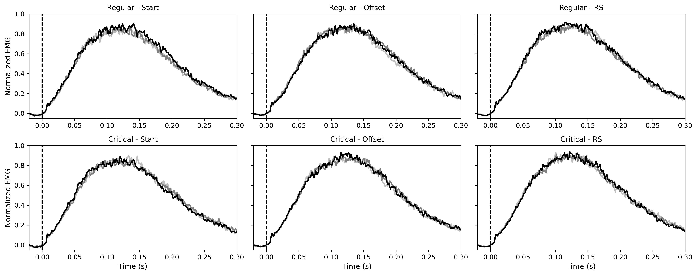
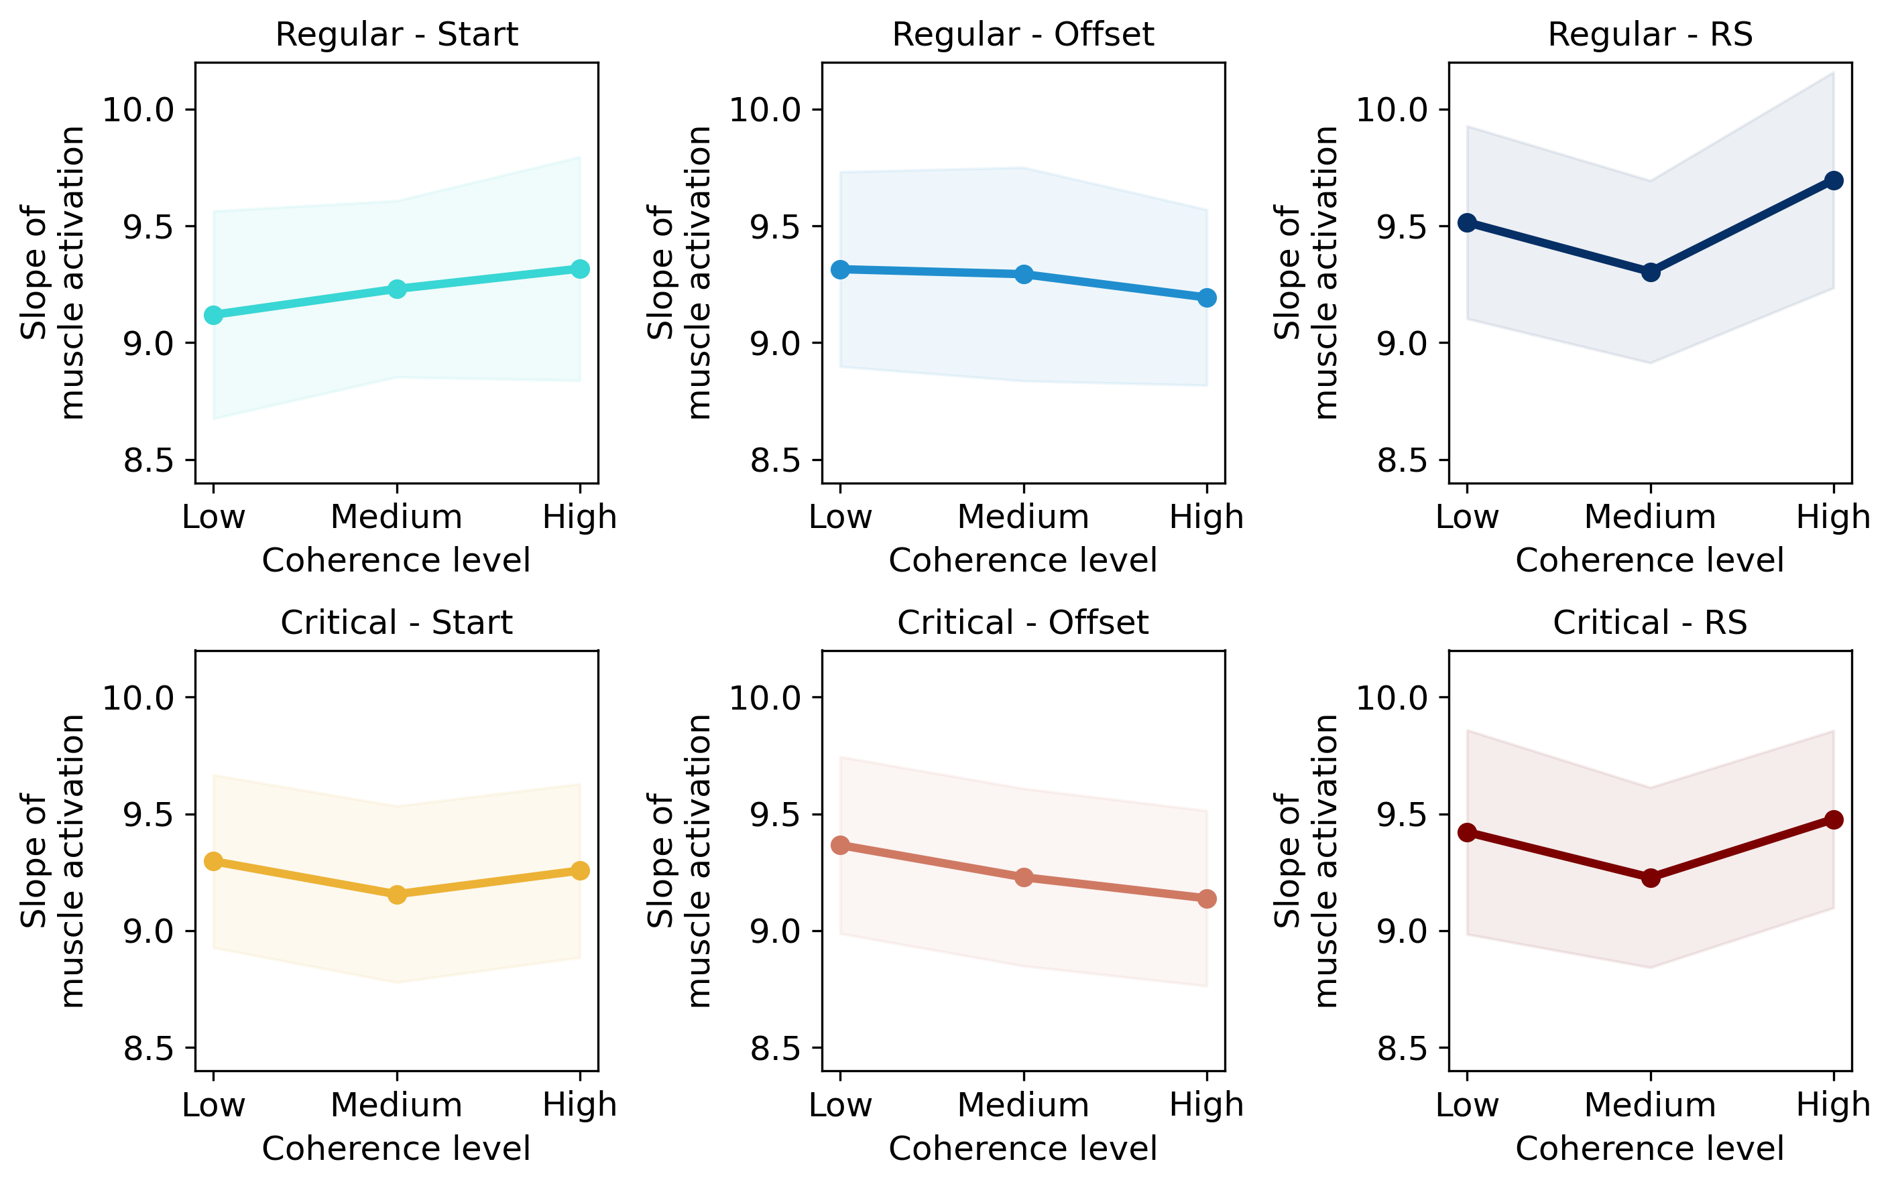
We observed similar slope of muscle activation between conditions (coherence in grey palette; colors reflect conditions) with no effect of coherence on slope of muscle activation (all BF_{incl} < 0.33 and p > .05).

Slide 9
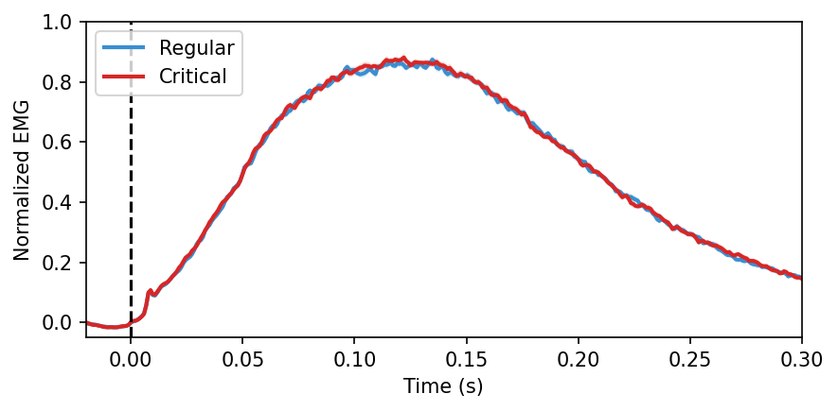
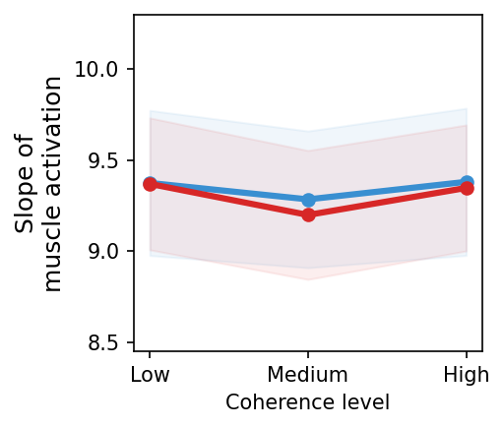
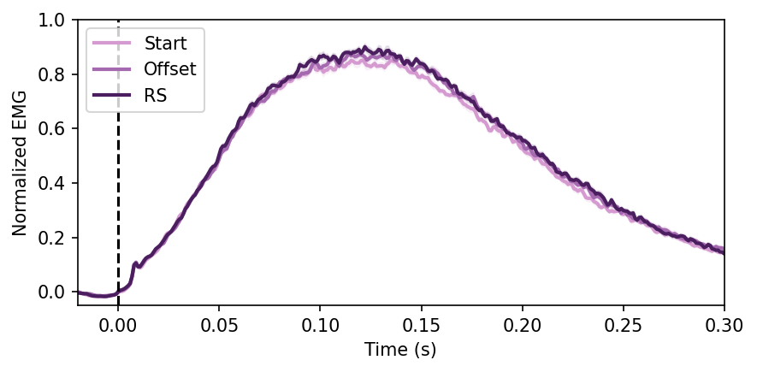
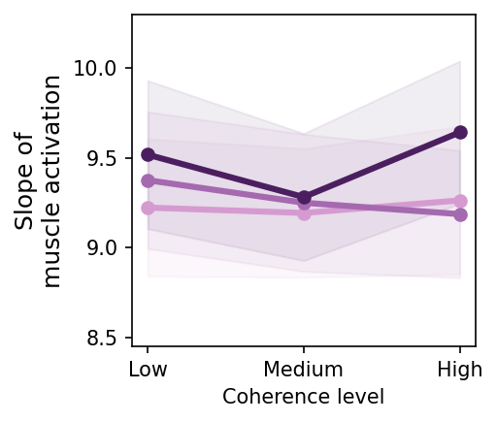
Note. Contrary to mean MET, slope of muscle activation did not change between trial value.
p = 0.604
BF_{incl} = 0.33
p = 0.142
BF_{incl} = 0.62

Slide 10
Now, we focused on partial muscle activations (PMA) during the stimulus, delay and response period. We computed the average number of PMAs and estimated the PMA rate (events per second) using 0.1-s time bins to capture temporal dynamics. This was represented for EMG channel associated with the response (no effect was observed in the opposite channel).
We analyzed PMA rates using repeated-measures ANOVAs including value, reward-onset timing, coherence, and time bin (0.1 s) as within-subject factors. We first report results from the full model to assess main effects and interactions.
Next, we analyzed marginal means for each factor (reward-onset timing, trial value, coherence), while retaining time as a within-subject factor, as only interactions with time were observed in the full model. This approach simplifies model, increases statistical power, and facilitates clearer interpretation of main effects while preserving temporal dynamics.
Note. Bayesian rm ANOVA including all factors (value, reward-onset, coherence, and time bin) was not conducted due to excessive computational cost and time.

Slide 11
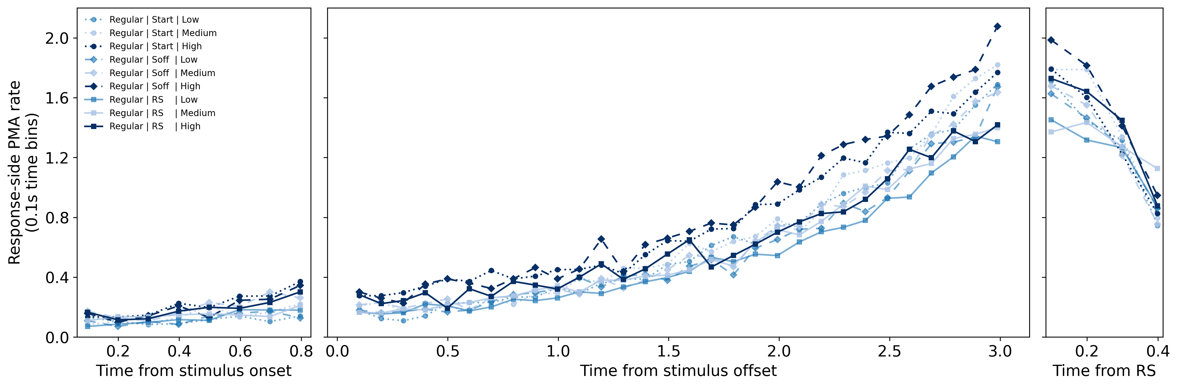
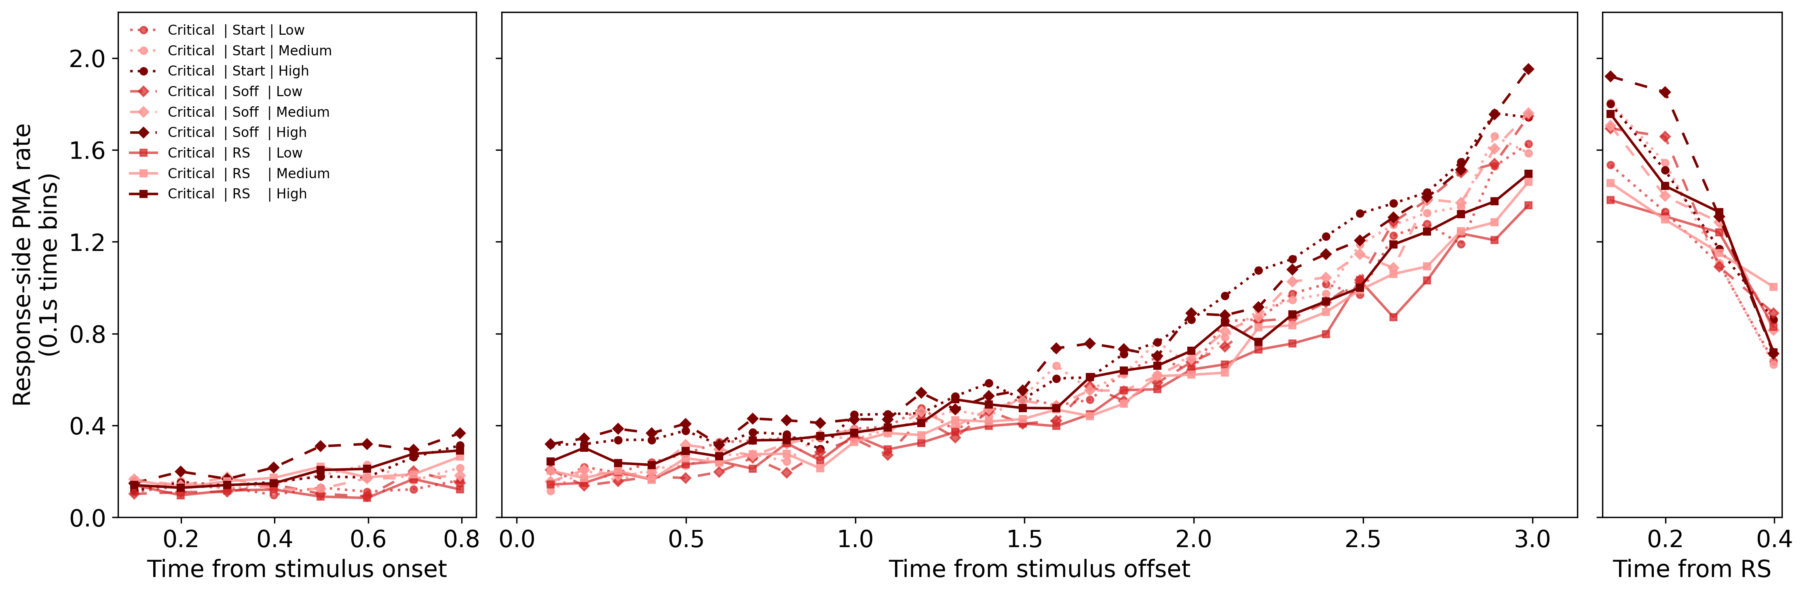
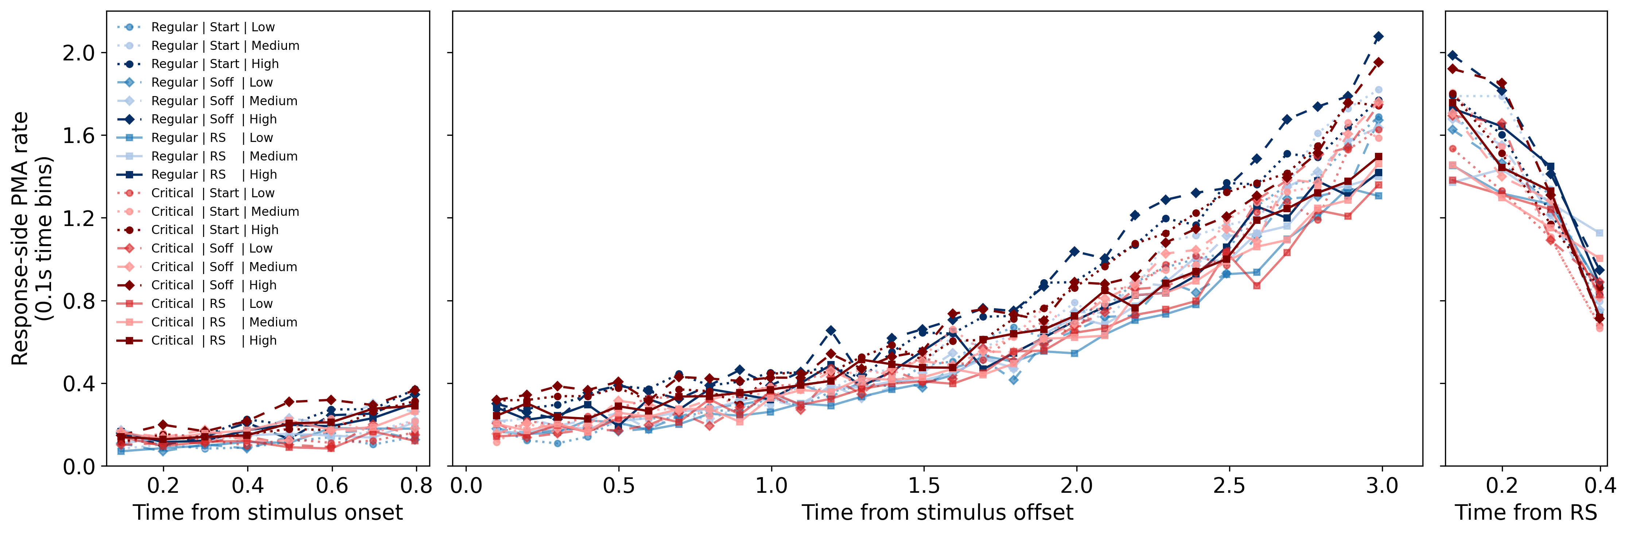
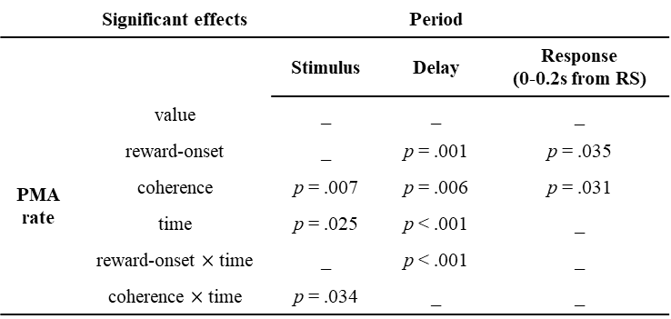
Full ANOVA analysis
We observed main effects of reward-onset timing, coherence, and time, with two interactions: coherence × time (stimulus period) and reward-onset timing × time (delay period).
In the following slide, we decomposed these effects into marginal analyses while retaining time as a within-subject factor, to simplify interpretation and facilitate visualization (with comparable results).
 | Significant effects |  | Period
 |  | Stimulus | Delay | Response (0-0.2s from RS)
PMA rate | value | _ | _ | _
 | reward-onset | _ | p = .001 | p = .035
 | coherence | p = .007 | p = .006 | p = .031
 | time | p = .025 | p < .001 | _
 | reward-onset $×$time | _ | p < .001 | _
 | coherence $×$time | p = .034 | _ | _

Slide 12
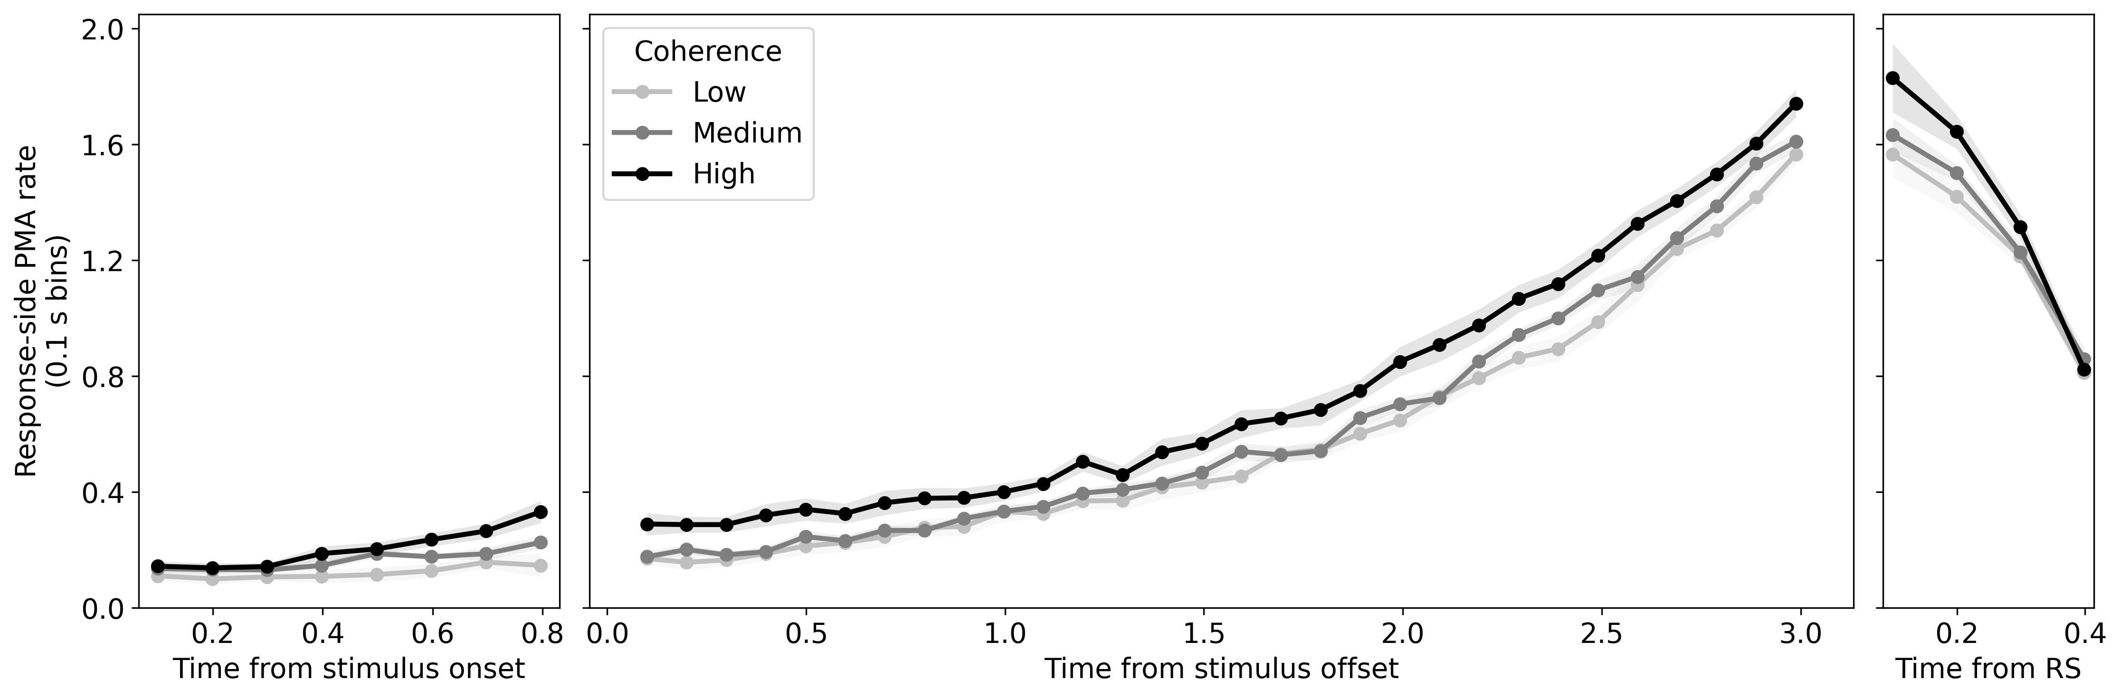
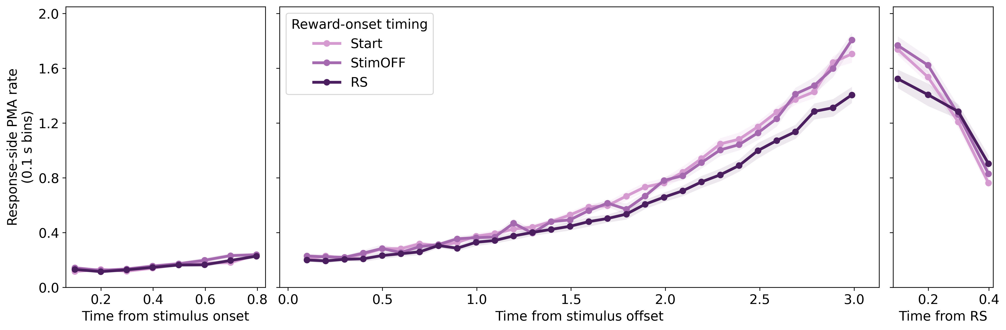
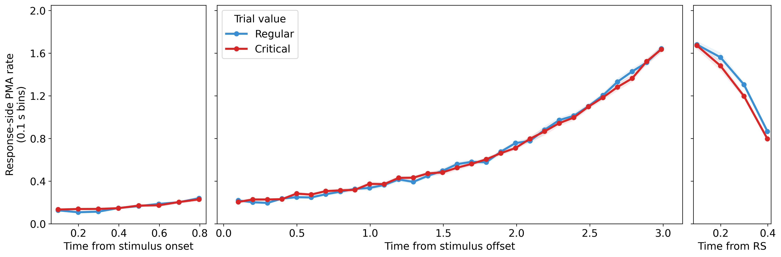
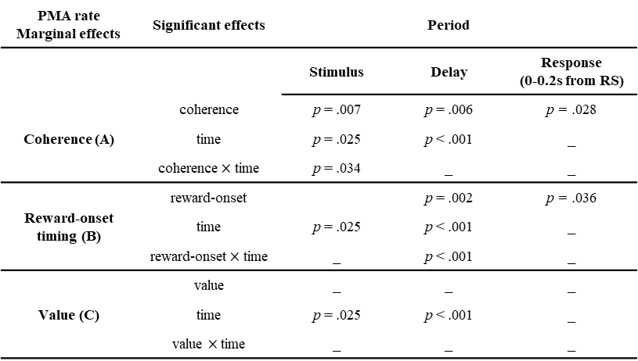
Marginal means
During the stimulus period, PMA rate followed an accumulation-like pattern, with a stronger increase over time for higher coherence than for lower coherence.
During the delay period, PMA rate followed the predictions of our model framework, showing a sustained increase over time and higher activity for high coherence trials (A). PMA rate was reduced for the RS reward-onset timing as the RS approached (B), and no difference was observed between regular and critical trials (C).
During the response period, PMA activity showed a similar pattern to the delay period, with main effects of coherence and reward-onset timing.
(A)
(B)
PMA rate Marginal effects | Significant effects |  | Period
 |  | Stimulus | Delay | Response (0-0.2s from RS)
Coherence (A) | coherence | p = .007 | p = .006 | p = .028
 | time | p = .025 | p < .001 | _
 | coherence$×$time | p = .034 | _ | _
Reward-onset timing (B) | reward-onset |  | p = .002 | p = .036
 | time | p = .025 | p < .001 | _
 | reward-onset$×$time | _ | p < .001 | _
Value (C) | value | _ | _ | _
 | time | p = .025 | p < .001 | _
 | value $×$time | _ | _ | _
(C)

Slide 13
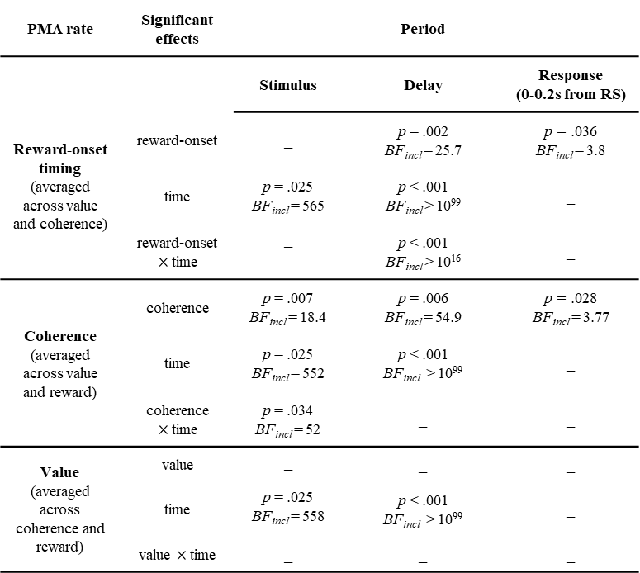
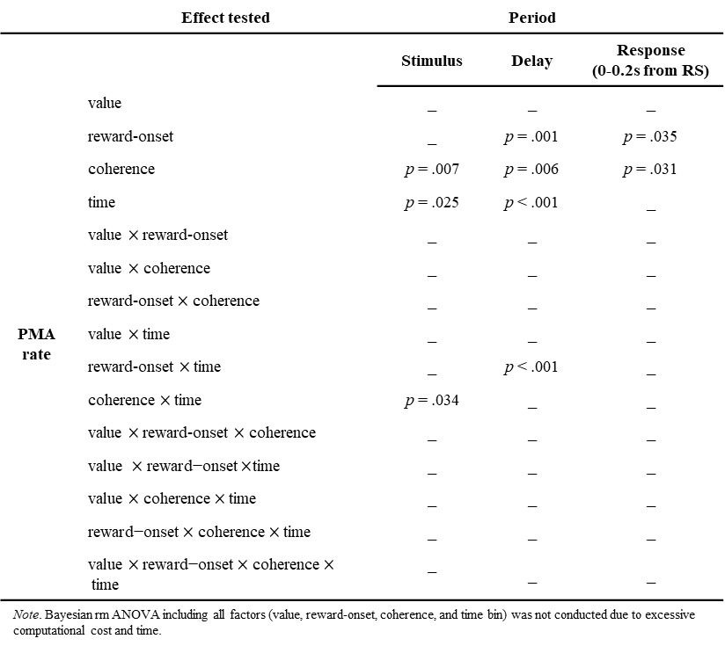
Summary
Table 2
Significant effects from the full ANOVAs on partial muscle activation (PMA) rate in the EMG channel of the responding effector across task periods
Table 3
Significant effects from marginal mean ANOVAs on partial muscle activation (PMA) rate in the electromyographic channel of the responding effector across task periods
PMA rate | Significant effects |  | Period
 |  | Stimulus | Delay | Response (0-0.2s from RS)
Reward-onset timing (averaged across value and coherence) | reward-onset | _ | p = .002 BF_{incl} = 25.7 | p = .036 BF_{incl} = 3.8
 | time | p = .025 BF_{incl} = 565 | p < .001 BF_{incl} > 10⁹⁹ | _
 | reward-onset $×$time | _ | p < .001 BF_{incl} > 10¹⁶ | _
Coherence (averaged across value and reward) | coherence | p = .007 BF_{incl} = 18.4 | p = .006 BF_{incl} = 54.9 | p = .028 BF_{incl} = 3.77
 | time | p = .025 BF_{incl} = 552 | p < .001 BF_{incl} > 10⁹⁹ | _
 | coherence $×$time | p = .034 BF_{incl} = 52 | _ | _
Value (averaged across coherence and reward) | value | _ | _ | _
 | time | p = .025 BF_{incl} = 558 | p < .001 BF_{incl} > 10⁹⁹ | _
 | value $×$time | _ | _ | _
 | Effect tested |  | Period
 |  | Stimulus | Delay | Response (0-0.2s from RS)
PMA rate | value | _ | _ | _
 | reward-onset | _ | p = .001 | p = .035
 | coherence | p = .007 | p = .006 | p = .031
 | time | p = .025 | p < .001 | _
 | value $×$reward-onset | _ | _ | _
 | value $×$ coherence | _ | _ | _
 | reward-onset$×$coherence | _ | _ | _
 | value $×$time | _ | _ | _
 | reward-onset $×$time | _ | p < .001 | _
 | coherence $×$time | p = .034 | _ | _
 | value $×$reward-onset $×$ coherence | _ | _ | _
 | $\text{value} ×\text{reward}\text{−}\text{onset}×$time | _ | _ | _
 | $\text{value}×$ coherence $×$time | _ | _ | _
 | $\text{reward}\text{−}\text{onset}×$ coherence $×$time | _ | _ | _
 | $\text{value}×\text{reward}\text{−}\text{onset}×$ coherence $×$time | _ | _ | _
Note. Bayesian rm ANOVA including all factors (value, reward-onset, coherence, and time bin) was not conducted due to excessive computational cost and time.

Slide 14
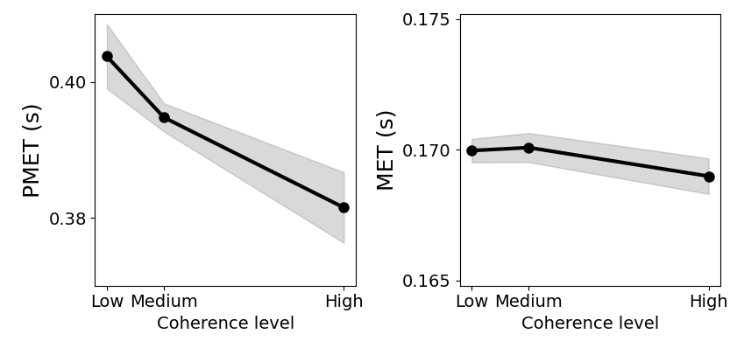
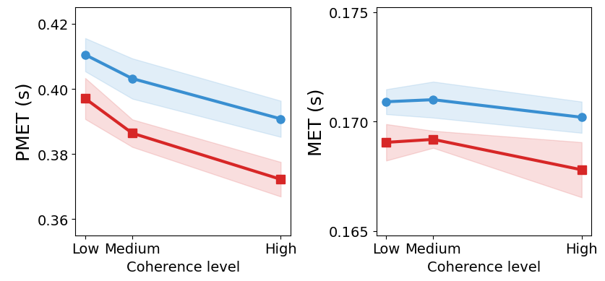
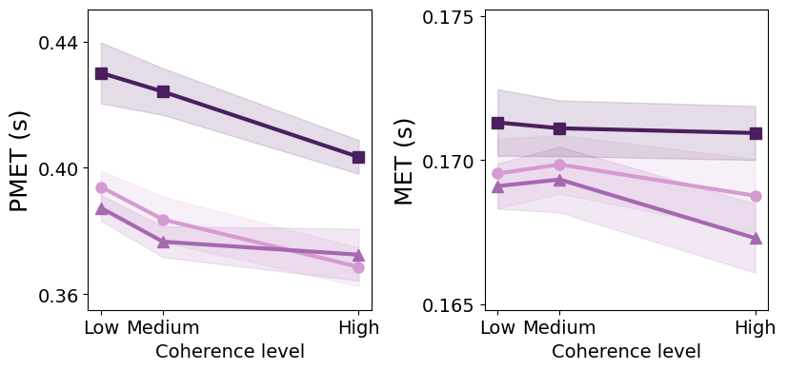
As a conclusion, I propose the following figure to illustrate how our model accounts for the main effect of each variable.
Note that, contrary to our main hypothesis, participants do not appear to “replay” decisions at RS (absence of MET modulation) ; instead results suggests a stronger attentional focus ?
(A)
Stimulus discriminability
(B)
Trial value
(C)
Reward-onset timing
Low
RS
Response
Critical
RS
Response
RS
RS
Response
Medium
Regular
Stimulus offset
High
Start trial
g
g
g
Delay period
Delay period
Delay period
mean PMET
mean MET
mean PMET
mean MET
mean PMET
mean MET

Slide 15
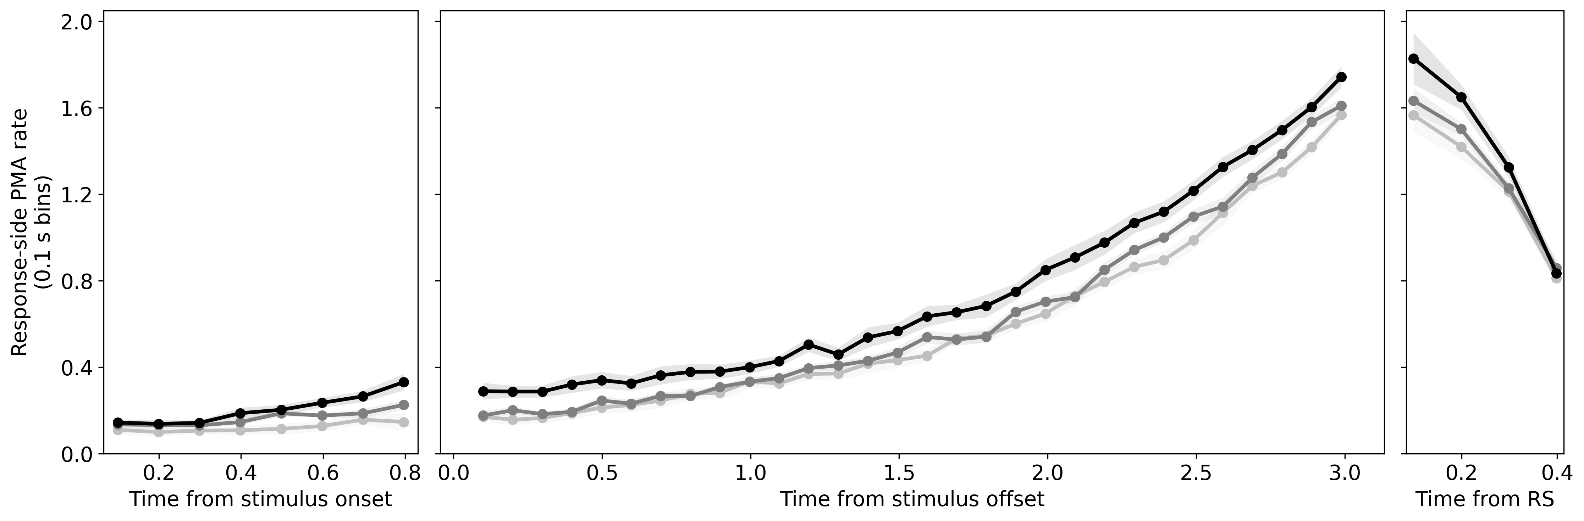
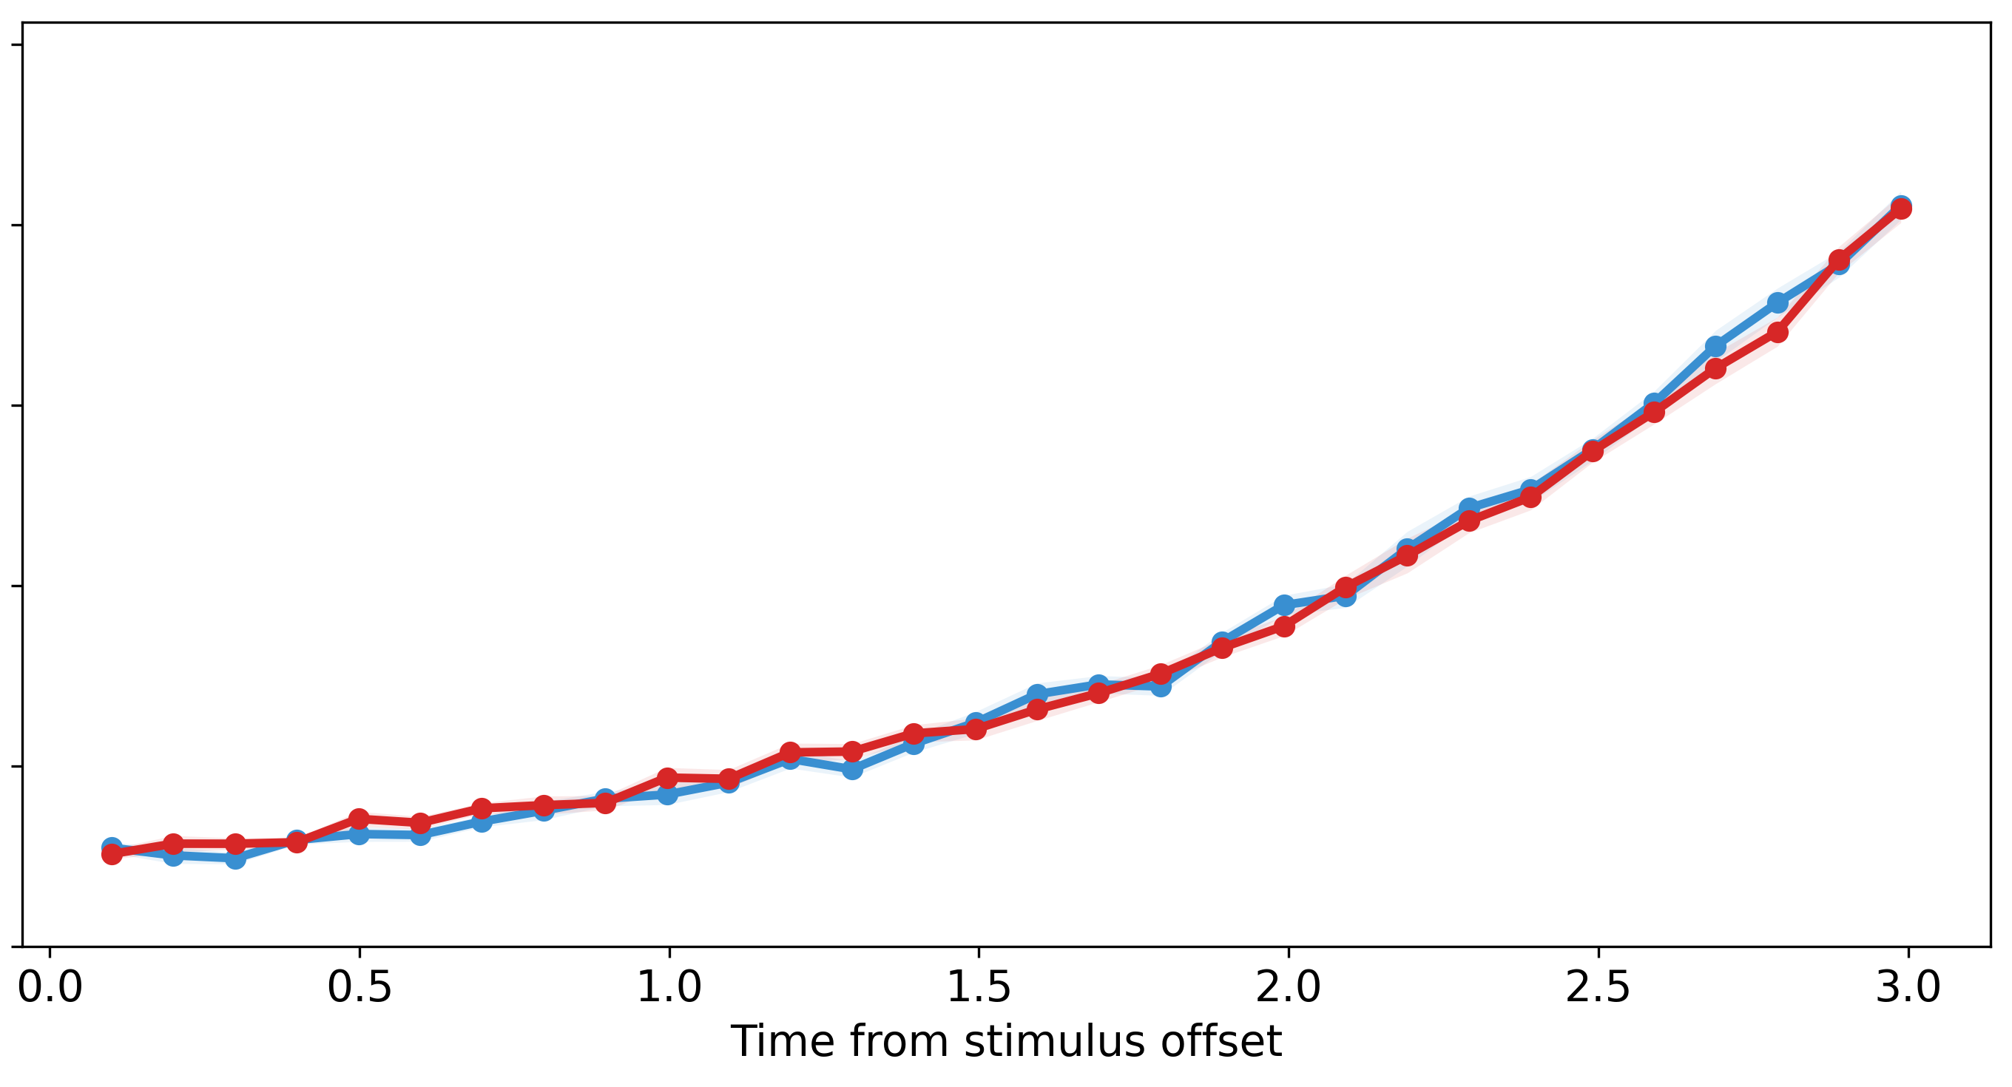
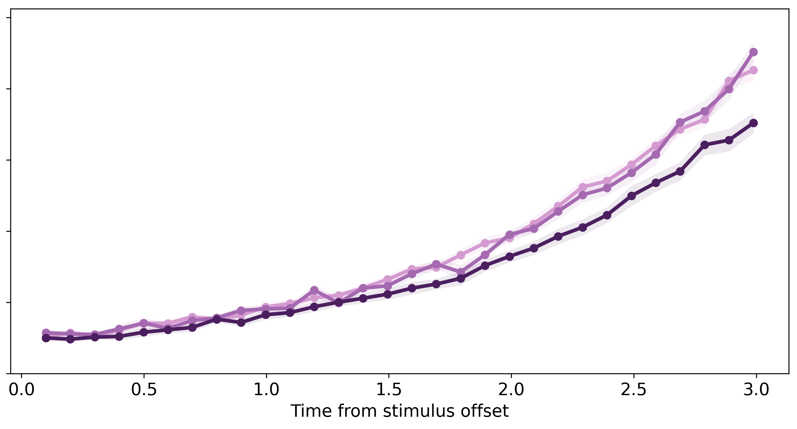
Stimulus discriminability
Trial value
Reward-onset timing
Low
RS
Response
Critical
RS
Response
RS
RS
Response
Medium
Regular
Stimulus offset
High
Start trial
g
g
g
(A)
(D)
(G)
Delay period
Delay period
Delay period
mean PMET
mean MET
mean PMET
mean MET
mean PMET
mean MET
(B)
(E)
(H)
(C)
(F)
(I)

Slide 17
Supplementary Figures

Slide 18
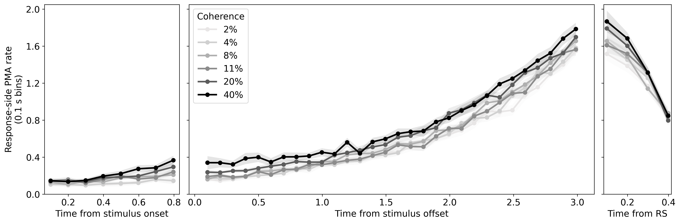

Slide 19
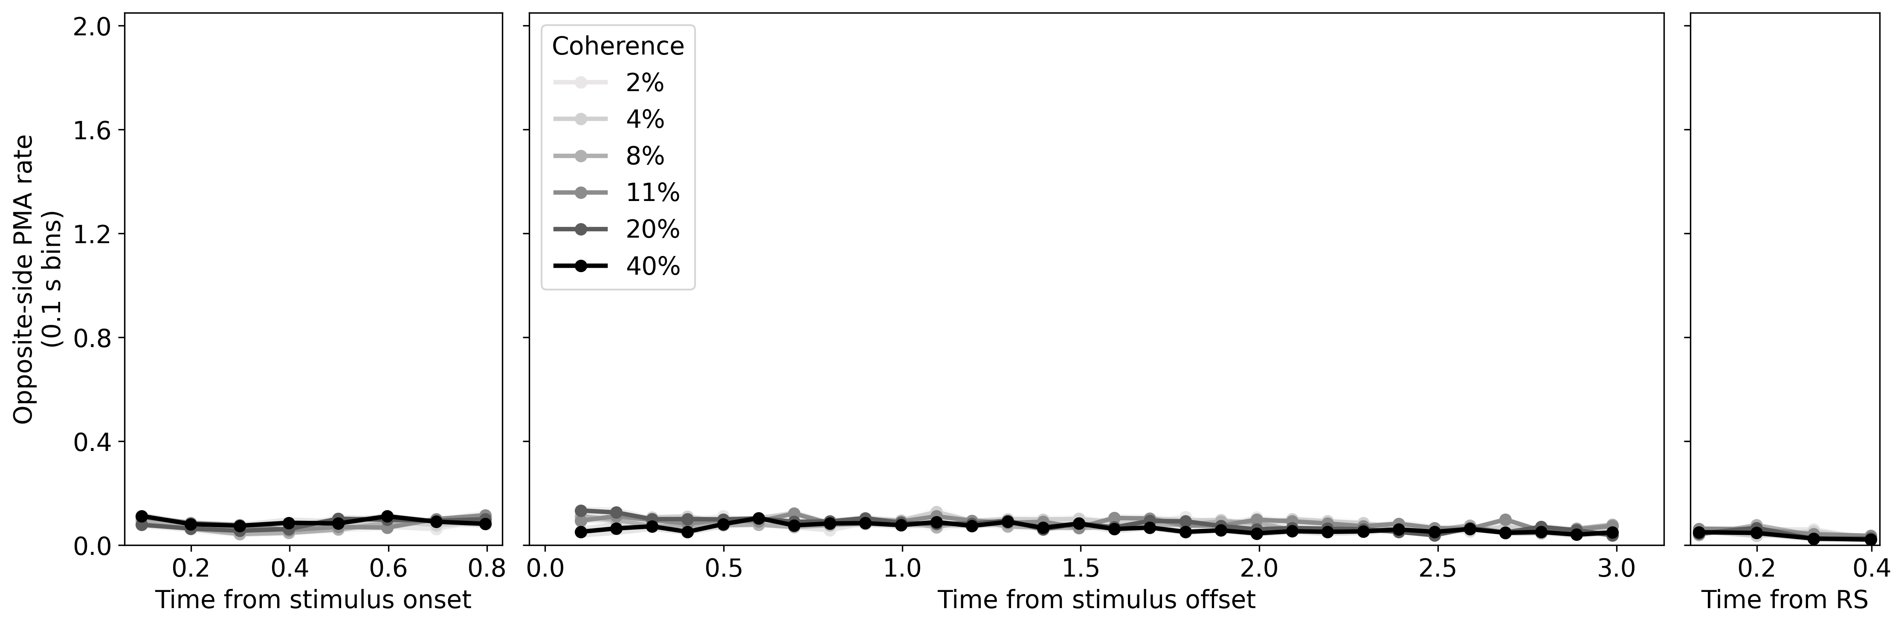

Slide 20
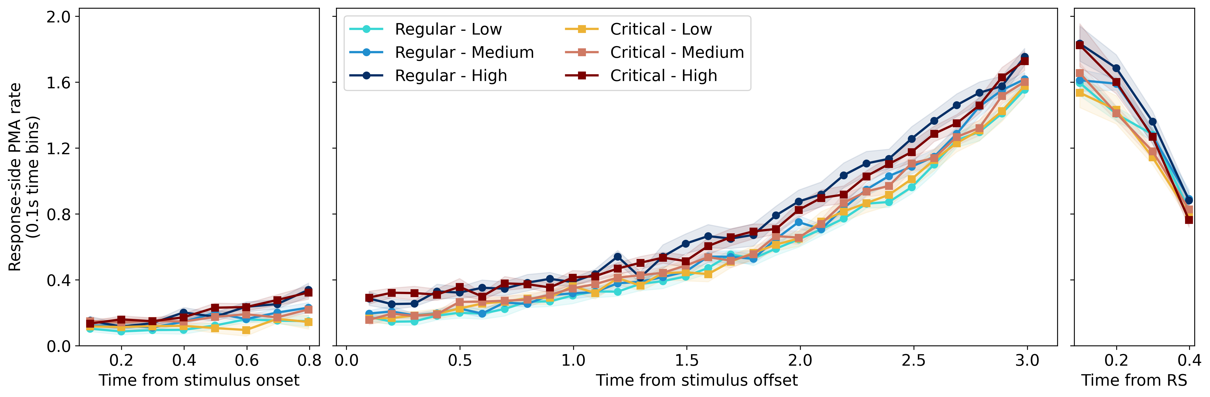
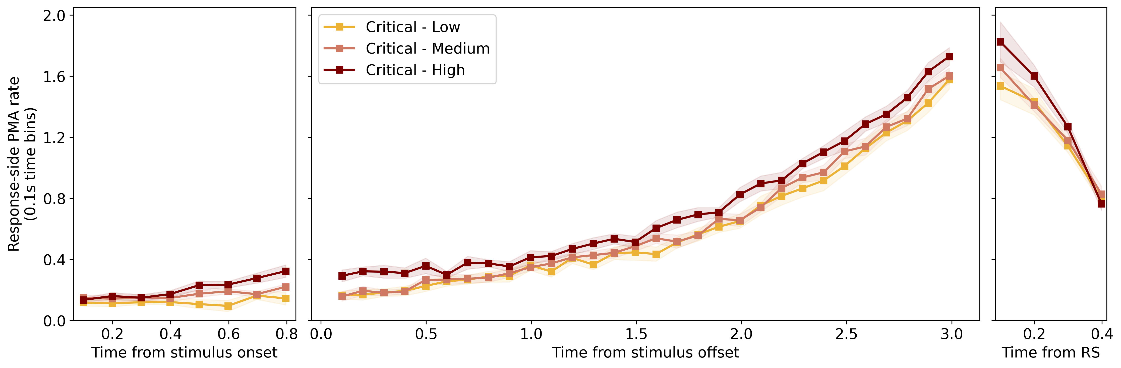
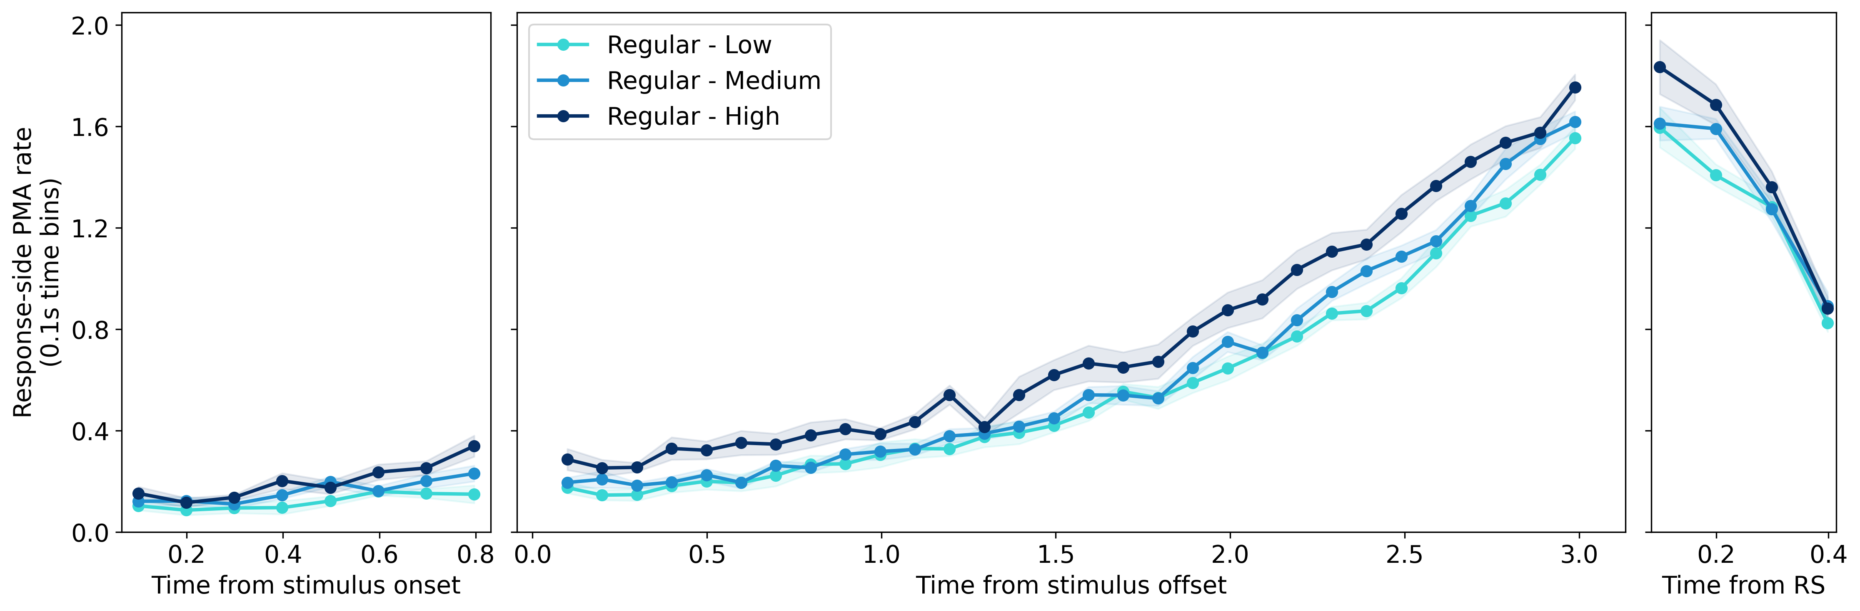

Slide 21
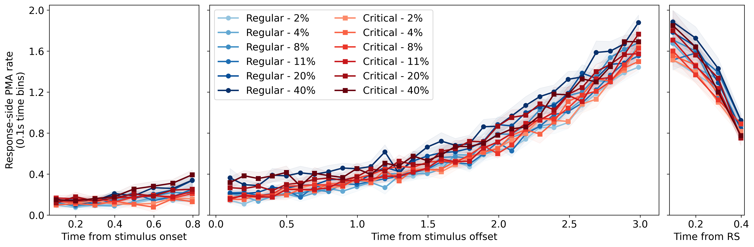
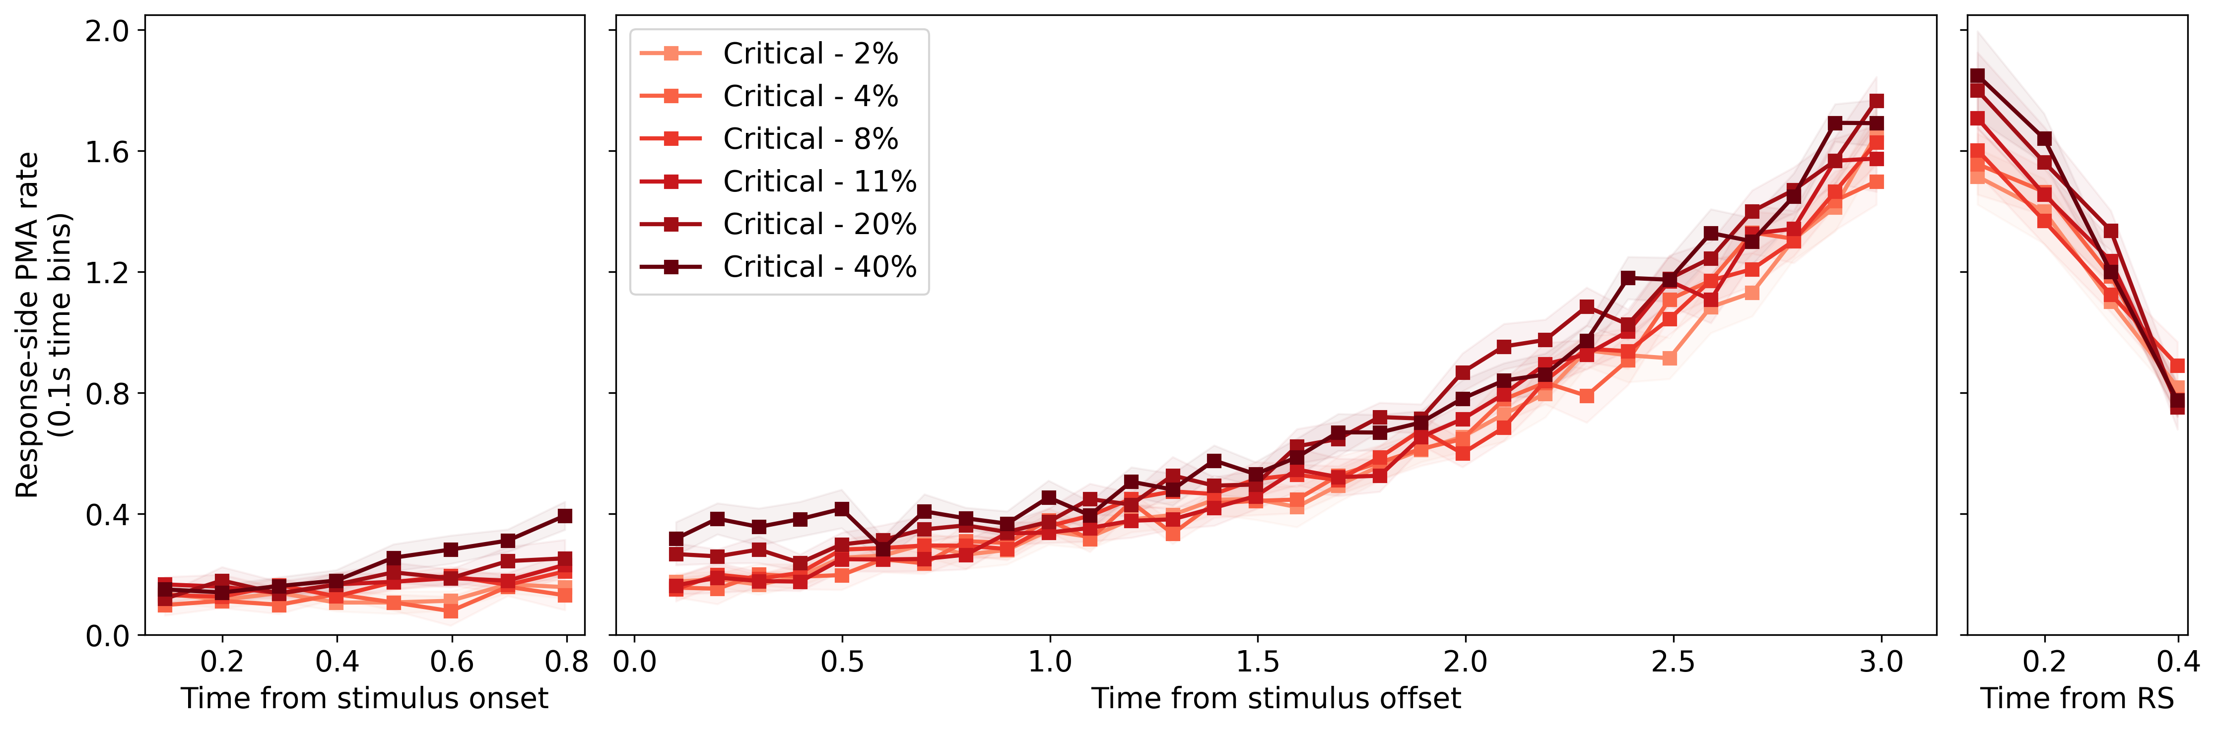
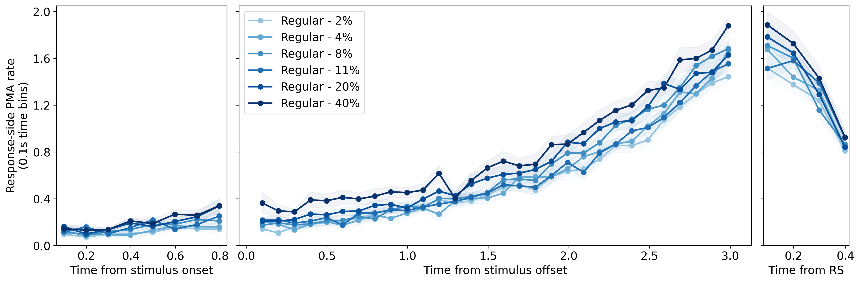

Slide 22
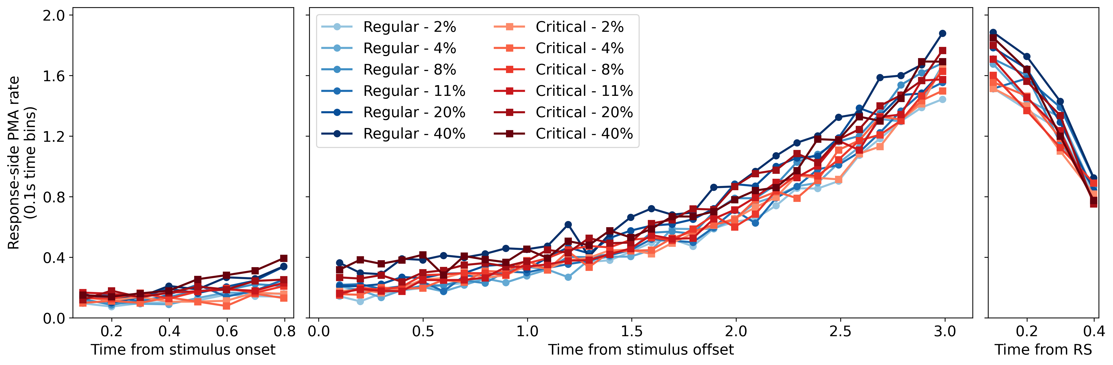

Slide 23
